Slide 1


MBA 652A STATISTICAL MODELLING FOR BUSINESS ANALYTICS ANALYSIS OF LIFE EXPECTANCY USING PANEL DATA REGRESSION
GROUP 08
RAJAN S. BANGAR 21114015
Under Supervision of:
Dr. Devlina Chatterjee

Slide 2

Objectives
Performing analysis on the WORLD BANK datasets for the “Life Expectancy” in more than 100 countries over last decade
Determining factors which are possibly affecting most on the life expectancy, through generation of various models
Examining common notion of people of every person that: # Do countries having higher GDP per capita will have higher life expectancy ? # Has Co2 emission directly affected life expectancy during last decade ?

Slide 3
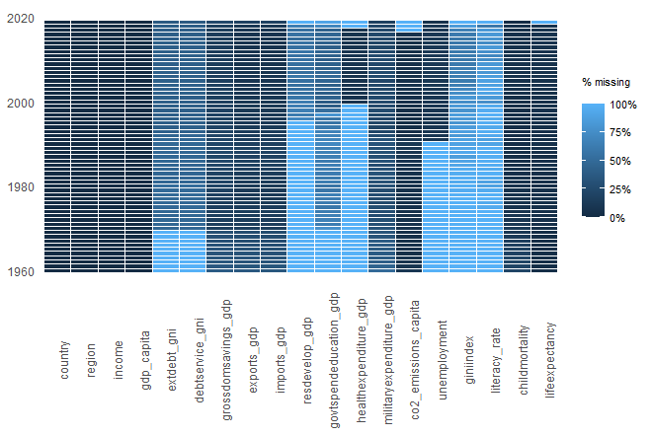
Missing VALUES

Slide 4

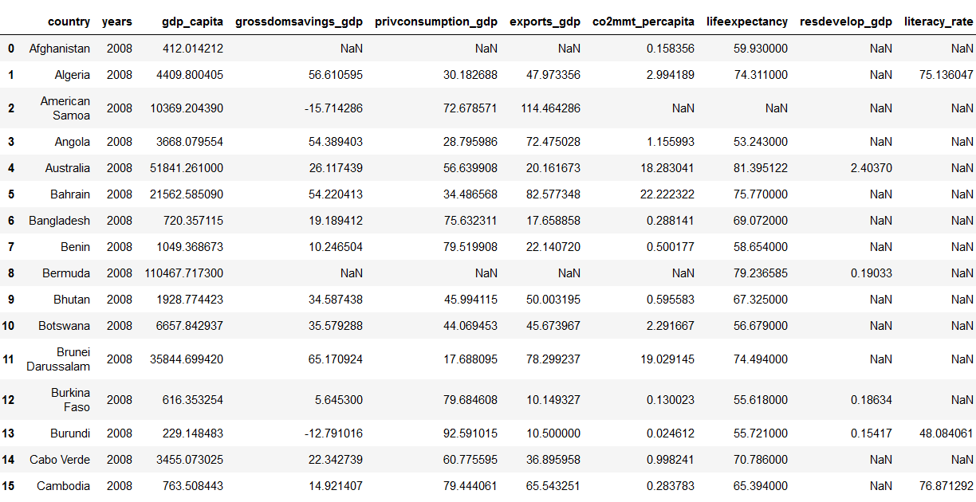
DATASET OVERVIEW

Slide 5
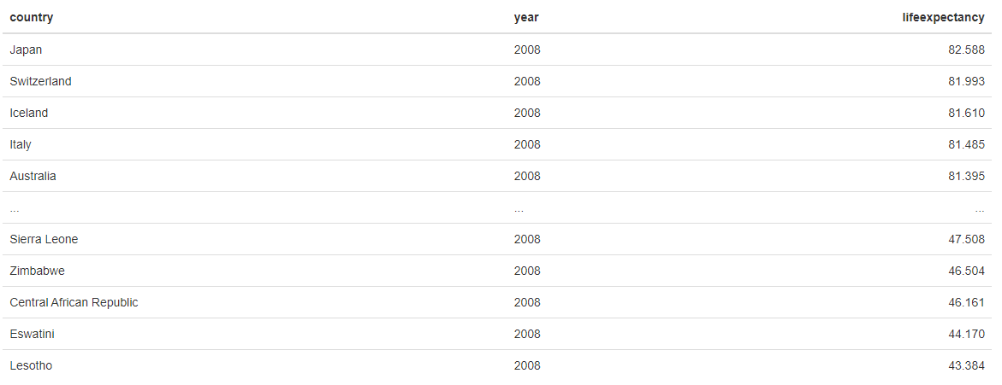
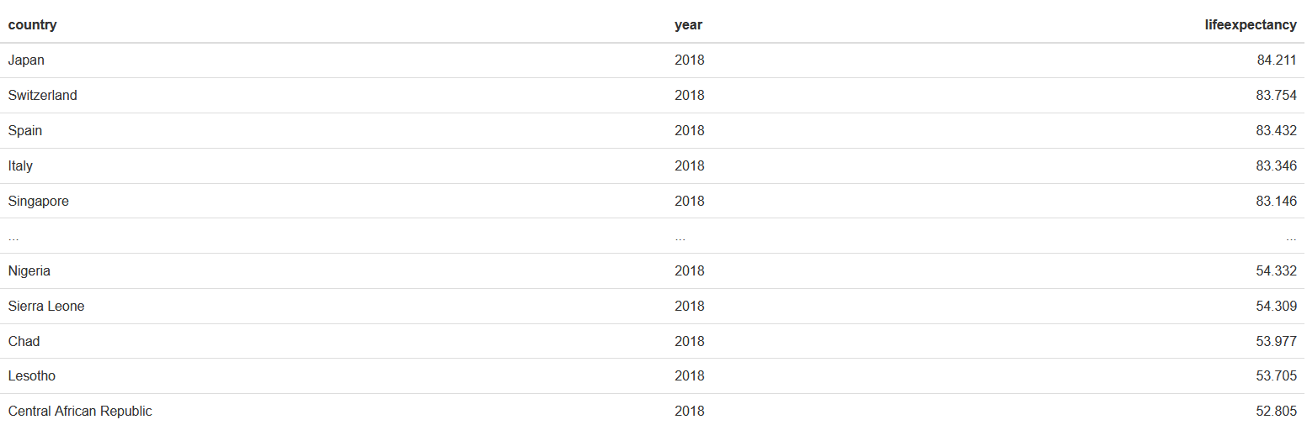

Slide 6
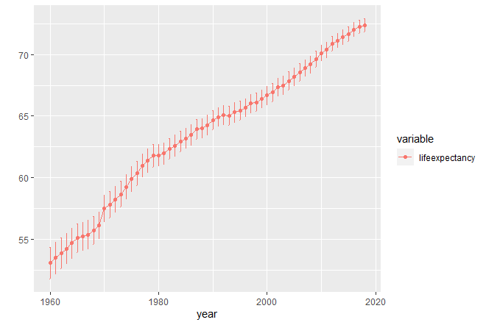
TREND GRAPH FOR Life expectancy

Slide 7
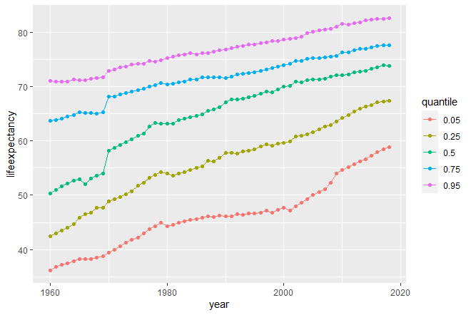
Quantile Trend graph

Slide 8
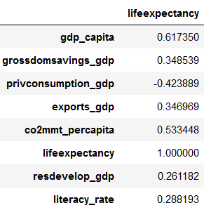
Correlation matrix

Slide 9
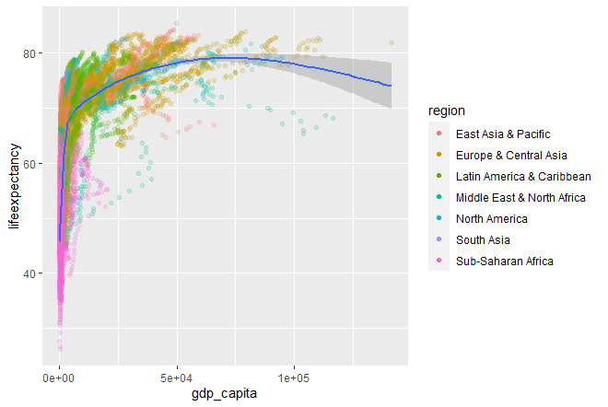
Life expectancy vs GDP per capita

Slide 10
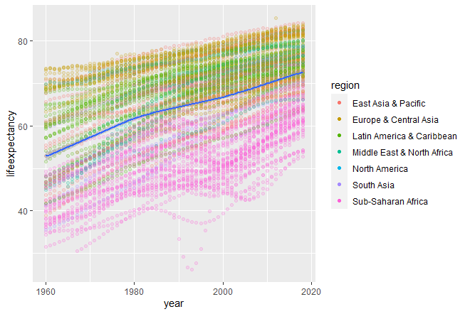
Life expectancy VS YEAR

Slide 11
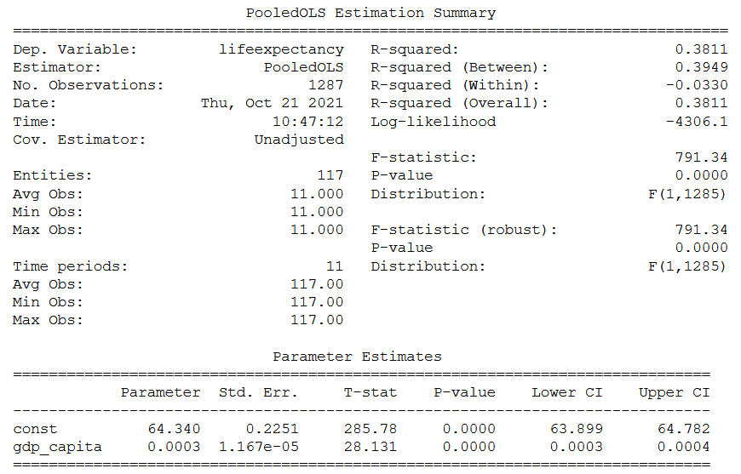
MODEl 1: using Pooled ols estimator
In this model, dependent variable: lifeexpectancy independent variable: gdp_capita
Only one independent variable is included in this model: gdp_capita, because of highest correlation factor found with value: 0.617, to analyse it’s sole effect
R2 value for this model: 0.38
lifeexpectancy = 64.340 + 0.003*gdp_capita
(0.2251) (1.167e-05)

Slide 12
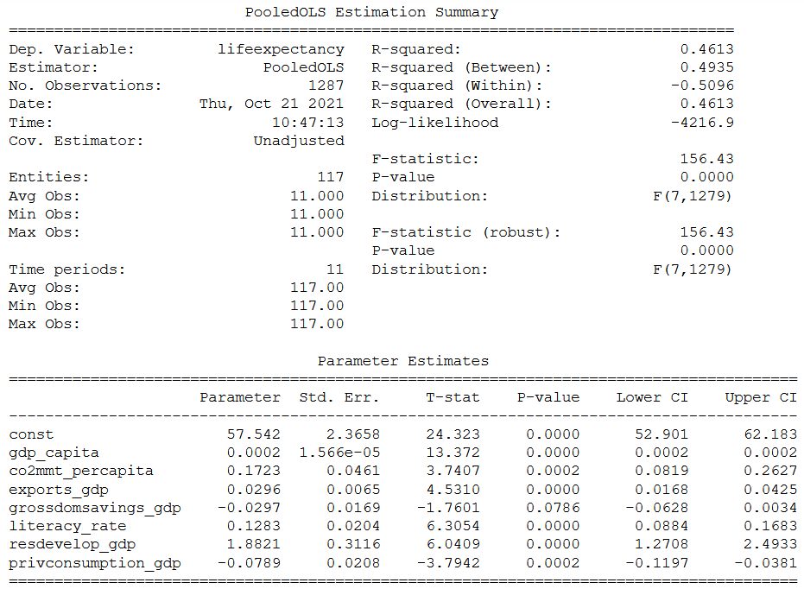
MODEl 2: using Pooled ols estimator
R2 value for this model: 0.4613 (Improvement relative to previous model has been observed)
lifeexpectancy = 57.542 + 0.0002*gdp_capita + 0.1723*co2mmt_percapita + 0.0296*exports_gdp - 0.297*grossdomsavings_gdp + 0.1283*literacy_rate + 1.8821*resdevelop_gdp – 0.0789*privconsumption_gdp
(2.3658) (1.566e-5) (0.0461) (0.0065) (0.0169) (0.0204) (0.3116) (0.0208)

Slide 13
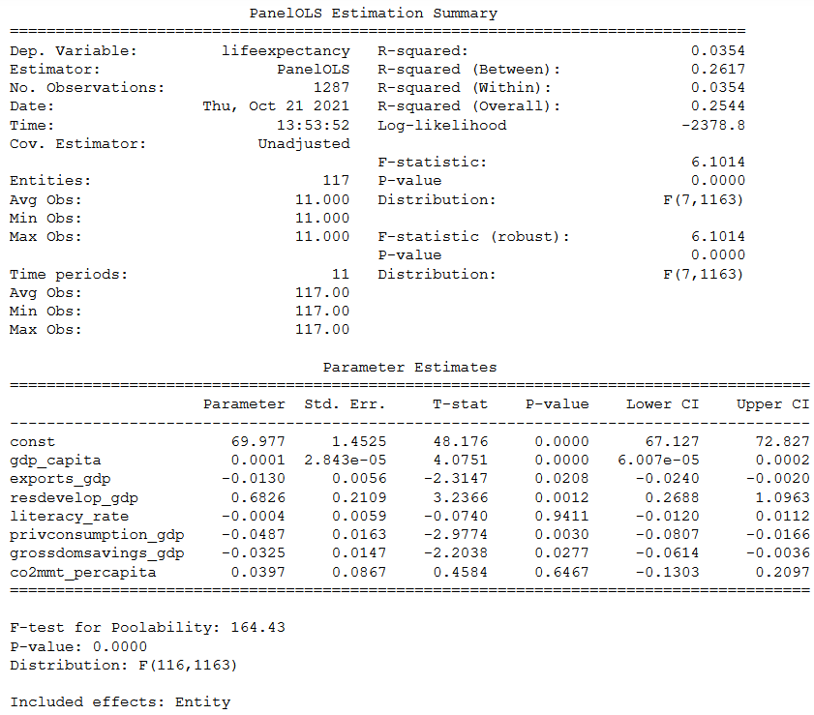
MODEl 3: using panel ols estimator
This PanelOLS model uses entity fixed effect (i.e., ENTITY FIXED EFFECT) to eliminate the entity specific components.
In this model, dependent variable: lifeexpectancy independent variable: gdp_capita, co2 emission, etc 6 factors are considered
R2 value for this model: 0.0354
lifeexpectancy = 69.977 + 0.0001*gdp_capita – 0.0130* exports_gdp + 0.6826*resdevelop_gdp - 0.0004* literacy_rate – 0.0487*privconsumption_gdp – 0.0325*grossdomsavings_gdp + 0.0397*co2mmt_percapita
(1.4525) (2.843e-5) (0.0056) (0.2109) (-0.0004) (-0.487) (-0.0325) (0.0397)

Slide 14
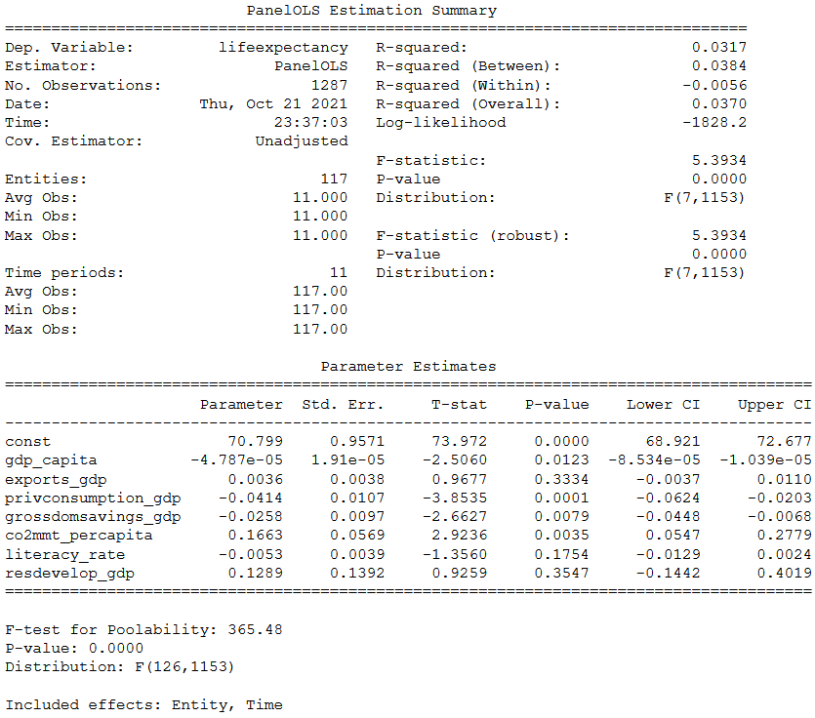
MODEl 4: using panel ols estimator
This PanelOLS model uses ENTITY as well as TIME FIXED EFFECT to eliminate the entity and time specific components.
R2 value for this model: 0.0317
lifeexpectancy = 70.799 - 4.787e-5*gdp_capita + 0.0036*exports_gdp – 0.0414*privconsumption_gdp - 0.258*grossdomsavings_gdp + 0.1663*co2mmt_percapita - 0.0053*literacy_rate + 0.1289*resdevelop_gdp
(0.9571) (1.91e-5) (0.0036) (0.0107) (0.0097) (0.0569) (0.0039) (0.1392)

Slide 15
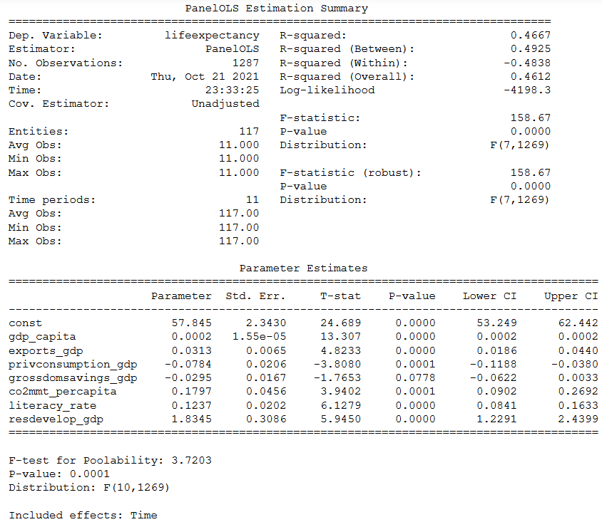
MODEl 5: using panel ols estimator
This PanelOLS model uses TIME FIXED EFFECT to eliminate the time specific components.
R2 value for this model: 0.4667
This is the best model in our study.
lifeexpectancy = 57.845 + 0.0002*gdp_capita + 0.0313*exports_gdp – 0.0784*privconsumption_gdp – 0.0295*grossdomsavings_gdp + 0.1797*co2mmt_percapita + 0.1237*literacy_rate + 1.8345*resdevelop_gdp
(2.3430) (1.55e-5) (0.0065) (0.0206) (0.0167) (0.0456) (0.0202) (0.3086)

Slide 16
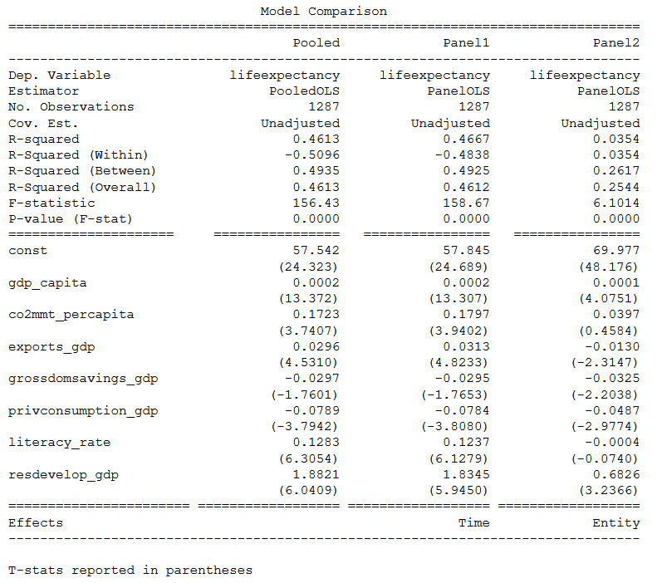
Pooled vs panel data models comparison
There is not large difference in values of R2 between models no.2 & 5, which are based on PooledOLS & PanelOLS respectively, because there is not much possibility for improvement by covering time fixed effects causing omitted factors, which were absent.
This lead us to conclude that: Time fixed omitted variables which are being covered using Time fixed Panel OLS Regression are having minimal improvement, of magnitude 0.4667 from 0.4613.

Slide 17
Quantile Trend graph

Slide 18
conclusions
If we allow for the possibility that life expectancy changes over time because of global changes (like, e.g. medical discoveries, wars and conflicts, famine, draught, floods, pandemic diseases) and that countries come from different starting grounds (e.g., because of their geographic location), then we cannot observe a robust association of GDP per capita with life expectancy.
Yes, countries having higher GDP per capita do have higher life expectancy, but it’s not the caused/justified by sole effects of GDP per capita, the model requires supporting variables.
No, Co2 emission did not directly affected life expectancy during last decade !

Slide 19
DATA SOURCE
https://data.worldbank.org/

Slide 20
Thank You!

